Slide 1
Intelligent offer engine Team – Data Wranglers Represented by: Arindam Chatterjee Subhajit Pal Biplab chowdhury

Slide 2
What are our typical customer offers
Product Needs
Service Needs
Merchant Offers
We Can do much more
Expand our offer suite to customer’s lifestyle needs and life goals through relevant personalized nudges

Slide 3
Solution
AT A Glance
Intelligent offer engine
Data
Casa and cards transaction, Demographics, product engagement
Tech Stack
Algorithm
Collaborative filtering, LSTM used for offer personalization
Integration
Customer-offer mappings loaded as a graph DB in Neo4j for fast querying using cypher
Delivery platform
Delivered as a mobile app with possible integration with mobileX

Slide 4
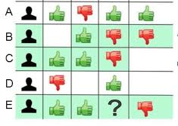


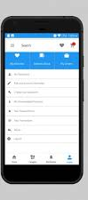
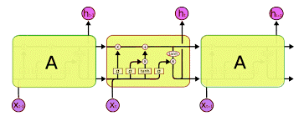
High level orchestration diagram of the product
Collaborative filtering
Offer mappings loaded in graph DB neo4j for fast query using cypher
Personalized offer and Nudges in a mobile App
Transaction data
LSTM
Developed on Internal HSBC DATA
Developed on simulated look alike data

Slide 5
Type of offers and personalized nudges
Recently closed a loan
Looking for Remittance
Forthcoming Bonus
…….
…..
…c
Less than regular savings in a month
Travel anniversary
Booked a travel without subscribing offer
Bought apparel without subscribing offer
Apparel merchants with tie up
Forthcoming deals in partner merchants
……..
….
…
Personal Finance Nudges
Update Mobile App
Changed Employer
………
…….
…..
…
Lifestyle / Lifegoal Nudges
Service Nudges

Slide 6


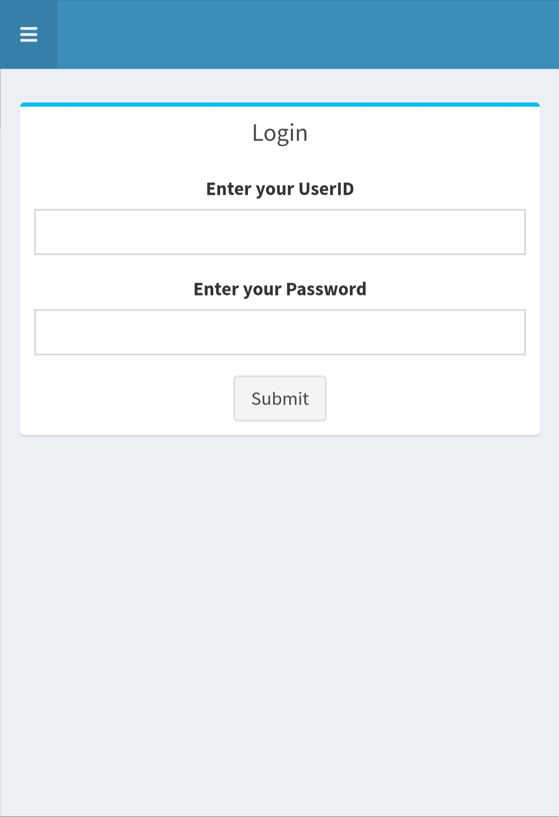
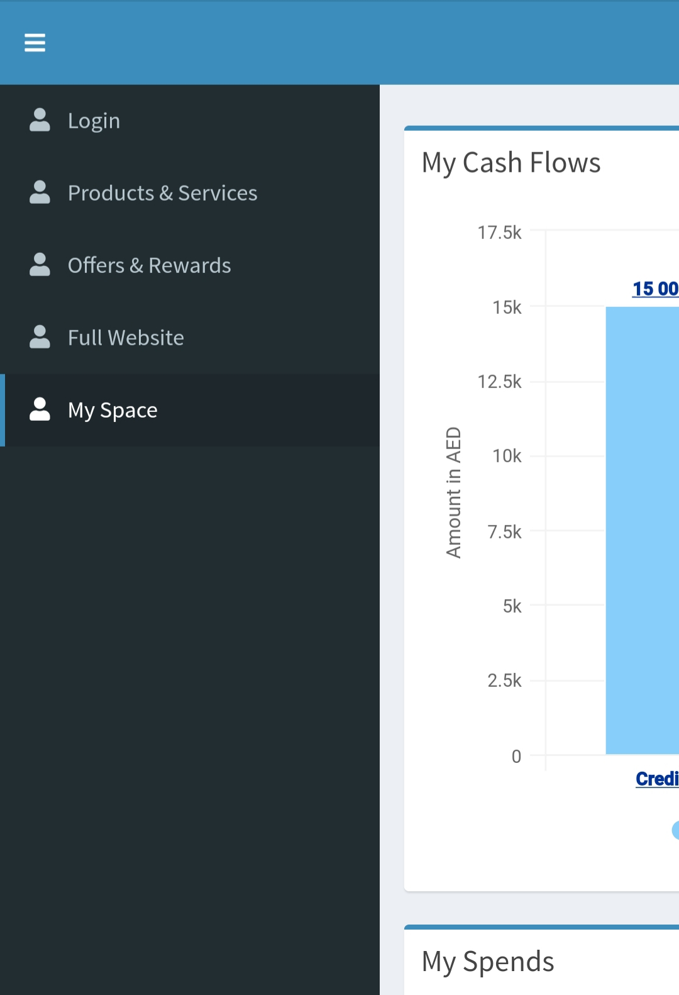
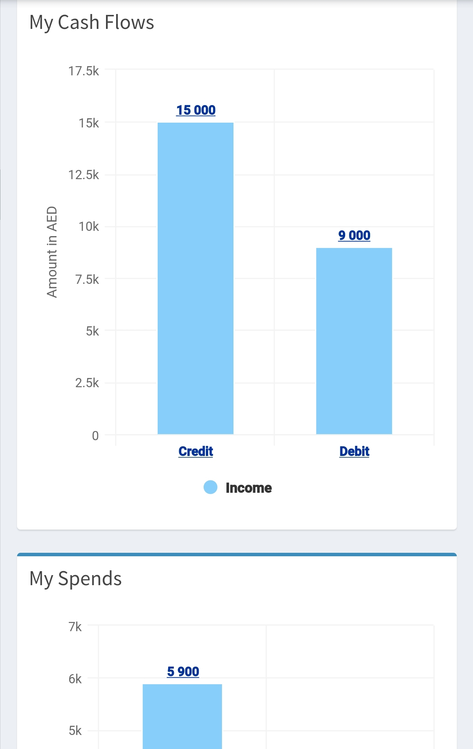
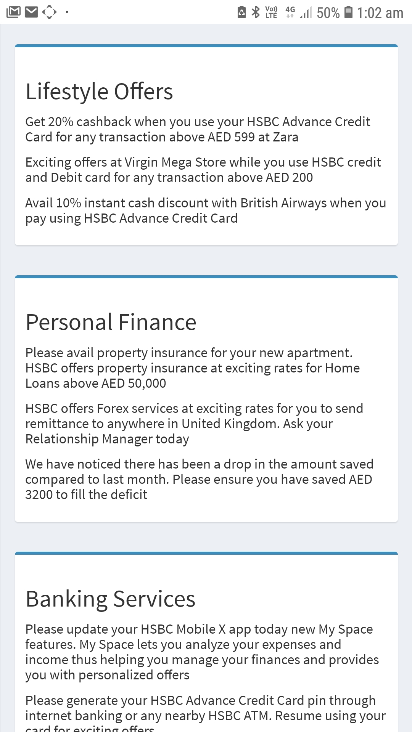
……these are not wire frame designs – these are screenshots from the live app…..

Slide 7
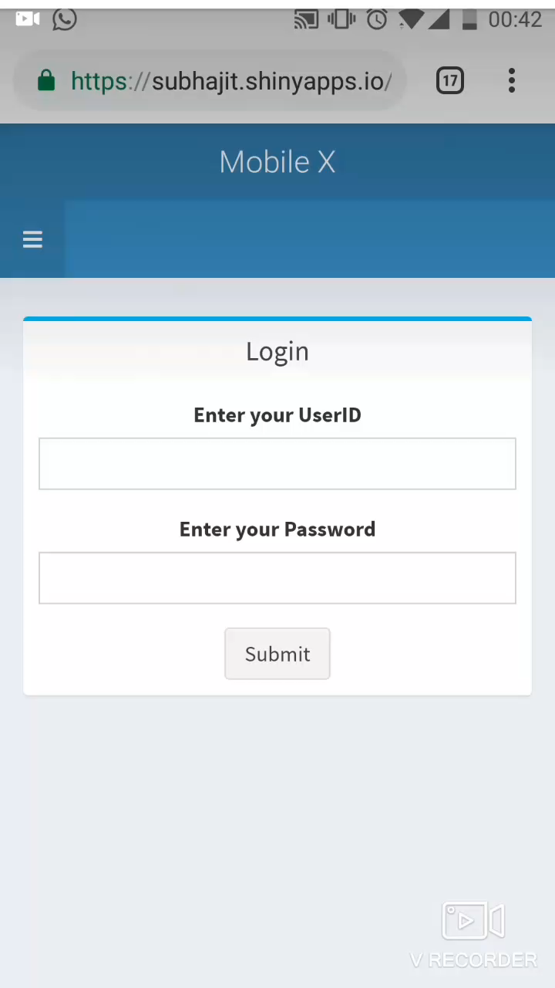
Click on the mobile screen and play the screen recording to see how the app works

Slide 8
How does graph DB help to query faster
In a conventional DB (relational DB / Data frame), storing all offers for all customers requires (#customers X #Offer) cells.
A significant proportion of cells are blank since all offers are not relevant for all customers (highly sparse table)
Graph DB organizes customers and offers as nodes and only relevant customer – offer pairs are connected by edges
Customer and offer attributes are stored as node properties
The prototype uses neo4j for graph DB and Cypher as the query language
Github Link for simulated data and Cypher code
https://github.com/Arindam-github/Storing-Offer-Recommendations-in-graph-db

Slide 9
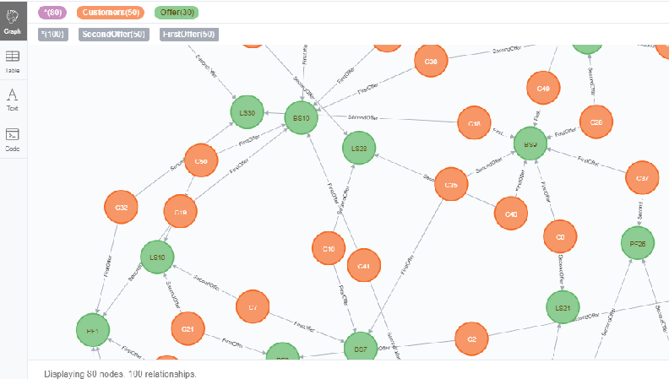
Customer – offer mappings stored as graph db
Customer Node
Offer Node

Slide 10
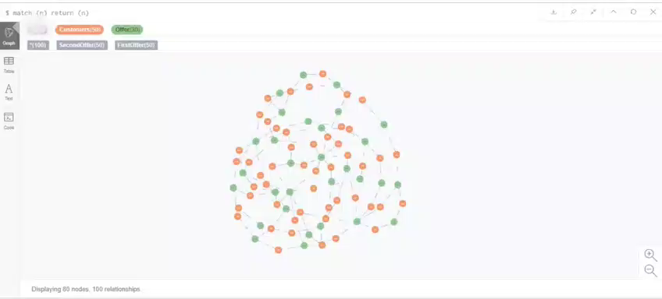
Play the video below to see how NEO4j stores customer – offer information as a graph DB

